Slide 1
Civil Rights & Labor SiteManager
Tina Collins - CRL
Janet Treadway - SM

Slide 2
Agenda
Welcome and Introductions
Functionality
System Requirements
Benefits
CRL Website Review
Demo
CRL (CRLMS) Payrolls
CRL (CRLMS) Subcontractor Payments
CRL (CRLMS) Bidder/Quoters – Primes
Questions/Wrap-up

Slide 3
System Functionality
AASHTOWare Project will manage the agency’s internal construction contract management program (Estimator, Pre-Construction, CRL, Construction/Materials, Bid)
CRL manages all aspects of internal and external civil rights and labor compliance activities:
DBE goals, TGB goals, and OJT goals
Bidders/Quoters
Contract Clearance and Good Faith Efforts
State and Federal Prevailing Wages Regulations
Federal/State Reporting Requirements
CRL will replace various tracking systems across the Department

Slide 4
Benefits
Allows electronic filing of contractor payrolls and subcontractors payments; instant Confirmation
Standardizes all contractors’ payroll reporting
Online prime contractor review and approval of subcontractor’s payrolls
Electronic signing of Documents
Reduction of Administrative workload; elimination of paper forms (printing, filing, long-term storage, and mailing)
Provides faster, easier, and accurate way to meet government reporting requirements
Eliminates hard copy forms

Slide 5
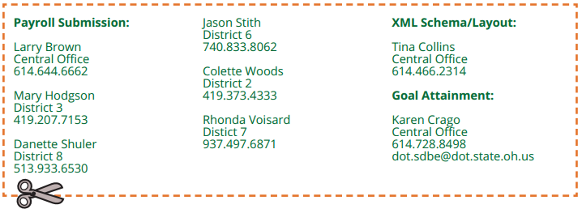
ODOT Support Network
ODOT District personnel (and Larry Brown) are the external support network business experts
CRL Website updated frequently
http://transportation.ohio.gov/crl/
Contact these individuals first for assistance

Slide 6
Implementation
CRL contract requirements are part of the contract
Required: All ODOT contracts advertised after April, 2015
Potential/Future: Local Let Project Tracking, End of 2015.

Slide 7
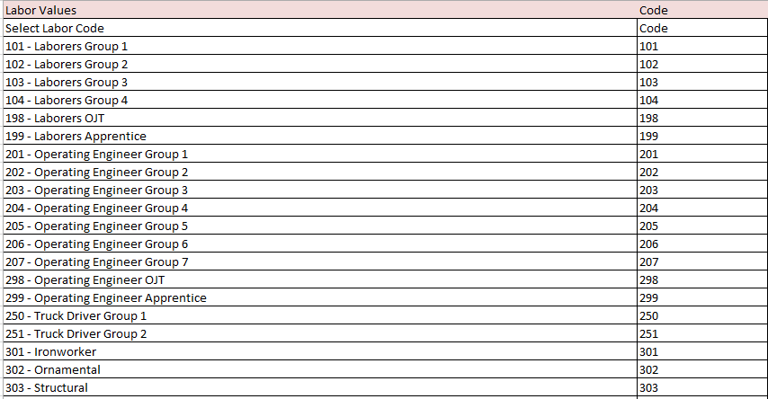
Craft & Labor Codes
Standardization of Craft & Labor Codes
Crosswalk?

Slide 8
Contractor Access
Apparent Low Bidder will receive access on day of bid opening (if new to the system)
Prime and Subcontractors assigned login usernames and passwords by ODOT
Contractors will only have access to contracts where they are ALB, Prime or Subcontractor

Slide 9
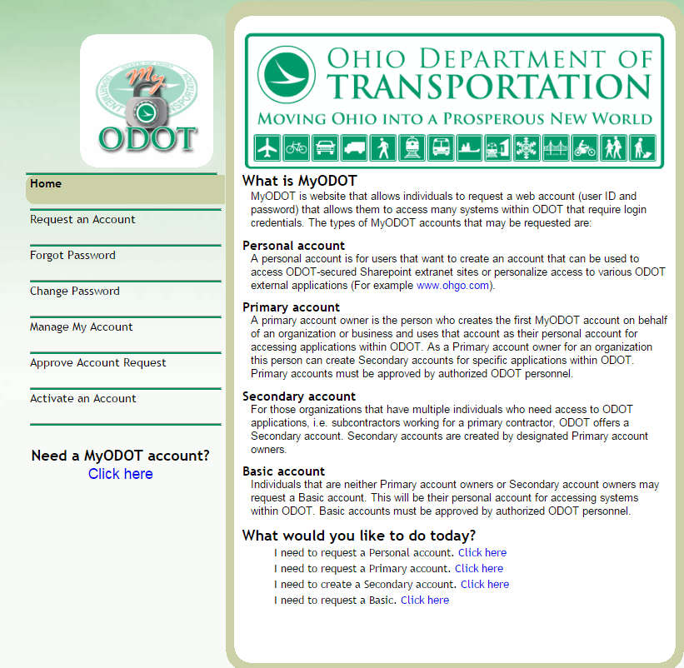
Contractor Access
http://myodot.dot.state.oh.us
User will enter their information into ID System
System will issue IDs

Slide 10
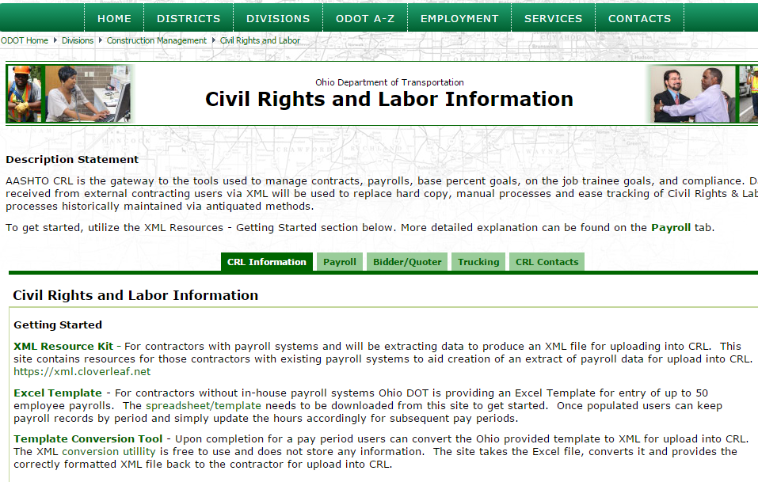
Methods of Delivery
XML Extract
Spreadsheet XML Upload

Slide 11
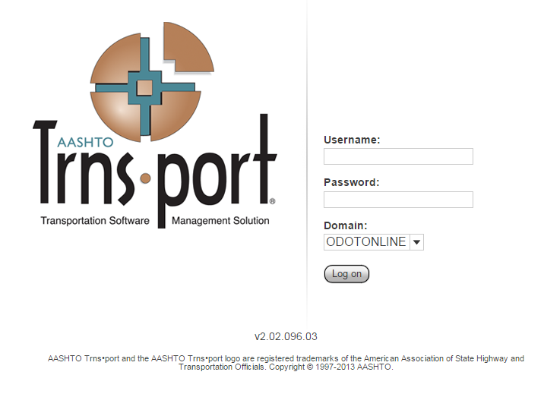
Logging In
https://project.transportation.ohio.gov/
Passwords are case sensitive
Make sure you change “Domain” to ODOTONLINE

Slide 12
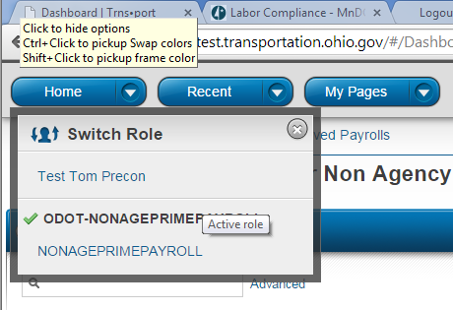
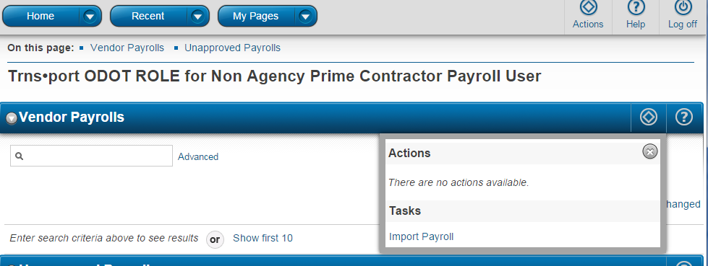
User Roles
Roles are part are part of the security of the system.
Make sure you are in the correct Role for the task you are performing
Roles you are assigned are located under the “Home” drop down arrow
From the component “Actions” menu, select “Import Payroll”

Slide 13
Payroll Submission via Spreadsheet
Please review the Spreadsheet Manual for information on how to properly complete the payroll spreadsheet.
Project ID Lookup
Contractor ID Lookup

Slide 14
CRL Website
Website Demo:
http://transportation.ohio.gov/crl/
Payroll Upload Demo
https://project.transportation.ohio.gov/

Slide 15
Adding Subcontractor Payment for Prime Contractors

Slide 16
Adding Subcontractor Payments for
Prime Contractors
Click the “Home” Dropdown Arrow
Select the ODOT-NONAGESUBPAYMENT Link

Slide 17
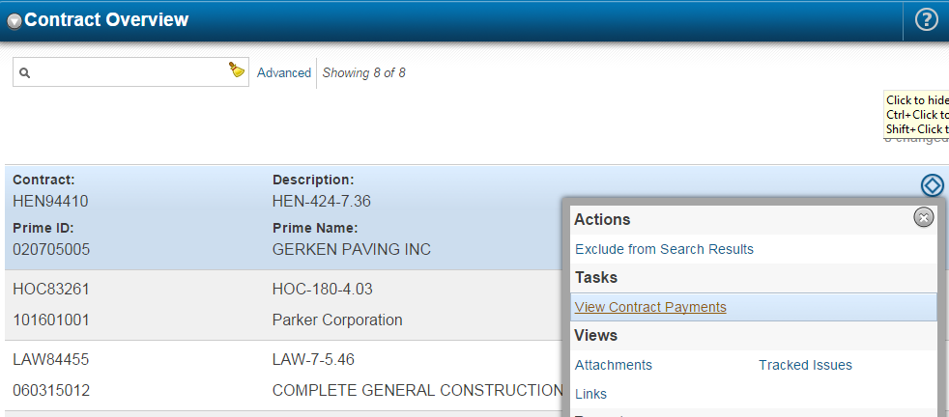
Viewing Contract Payments
You can search by contract number or list all contracts
Select “View Contract Payments” from the “Actions” menu

Slide 18
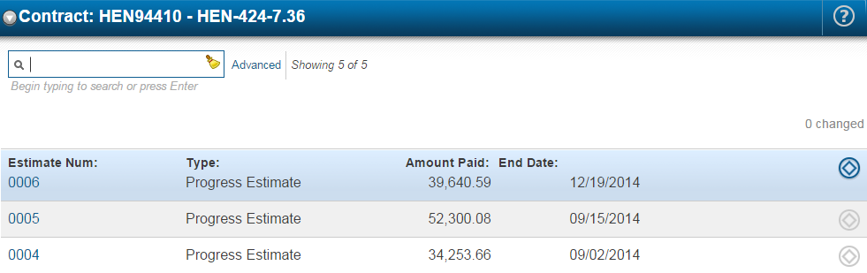
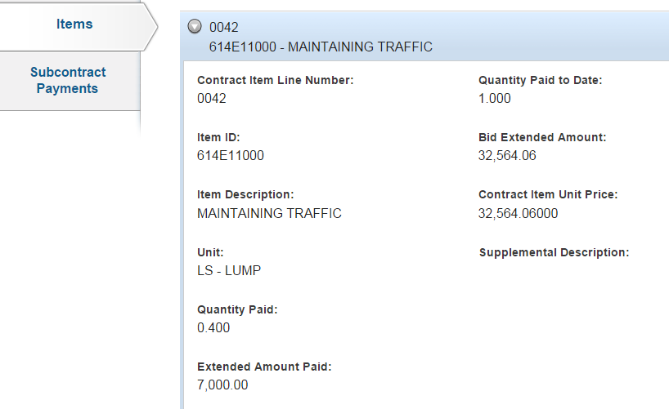
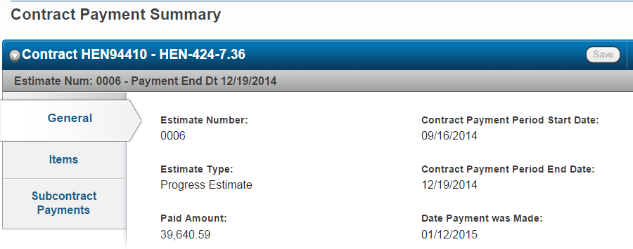
Select Estimate Number to View

Slide 20
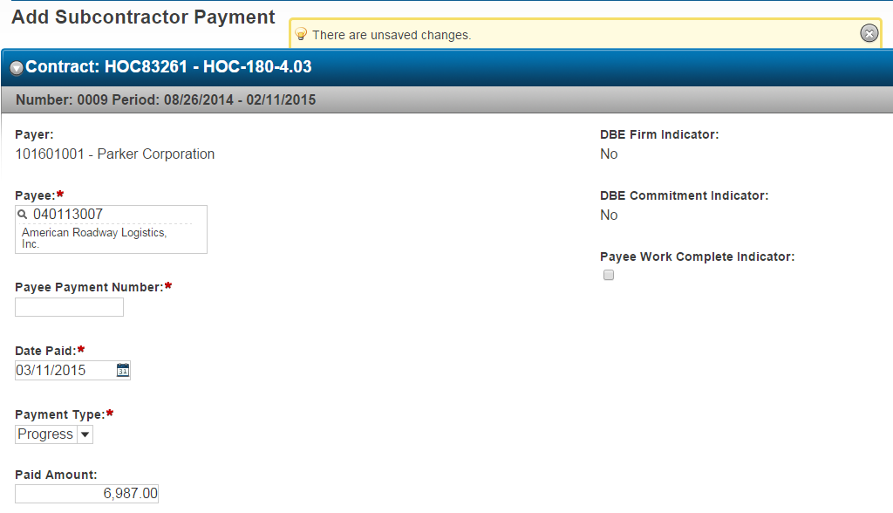
Search for the subcontractor in the Payee box
Enter Payment number in Payee Payment Number box
Enter the Date Paid
Enter Payment Type (Progress or Final)
Enter Paid Amount
Click Save

Slide 21
Review Subcontract Payment Report, then Click Next

Slide 22
Verifying the Payments Received as a Subcontractor

Slide 23
Click the Home Dropdown Arrow
Click the MNNONAGESUBPAYMENT link
Click the Home Dropdown Arrow
Click the MNNONAGESUBPAYMENT link

Slide 25
Click Yes as Expected
Enter Amount Received
Enter Date Received
Click Next

Slide 26
5. Click the Submit Verification button

Slide 27
CRL
Questions?

Slide 28
SiteManager
SiteManager – External Access
Contractors
Change Order approval
* Estimate approval – *in the future
Consultants
Inspection

Slide 29
SiteManager
SiteManager – External Access
Contractors
Change Order approval
District /Project staff will notify the Contractor when a change order is ready for review and approval
Change order documentation will be shared through the project SharePoint site
Contractor will approve at the first level for the change order in SiteManager

Slide 30
SiteManager
Requirements for your SiteManager access:
PersonManager account
First Name
Middle Initial
Last Name
Company
Email
Phone number
Indicate if you currently approve Change Orders on behalf of your company
Indicate if you currently approve Estimates on behalf of your company

Slide 31
SiteManager SharePoint Document Storage
Requirements for your SharePoint external access:
MyODOT account
Personal account request

Slide 32
SiteManager External Access assistance
In the future should have you any questions regarding your external access to either SiteManager or SharePoint you will be able to send an email to:
SiteManager.External@dot.state.oh.us

Slide 33
Questions?

